Slide 1
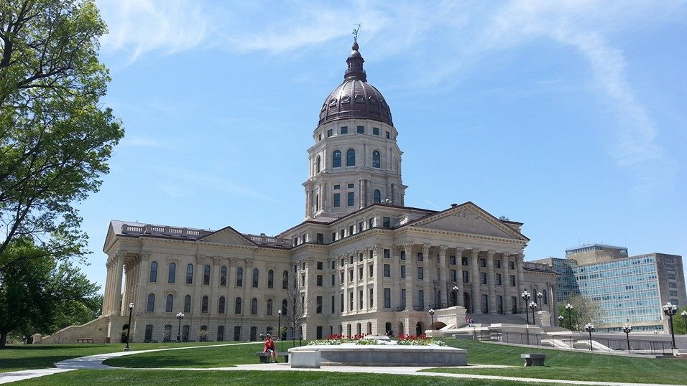
2022 Legislative Session Preview
Jay Hall
KAC Deputy Director and General Counsel

Slide 2
Legislative Tools
https://www.kansascounties.org/legislative/legislative-program
Policy Statement
Legislative Maps
Link to common terms
Links to other legislative resources

Slide 3
New Legislative Tools
https://www.kansascounties.org/legislative/kansas-counties-toolkit
Includes information on “Dark Store Theory” and “Constitutional Home Rule”

Slide 4
New Legislative Tools
https://www.kansascounties.org/legislative/2022-legislative-testimony
KAC Testimony will be available on our website

Slide 5
Legislative Liaisons
Meet each Friday via Zoom
Talk about legislative issues
Share information

Slide 6
Legislative Update
Politics
Politics

Slide 7
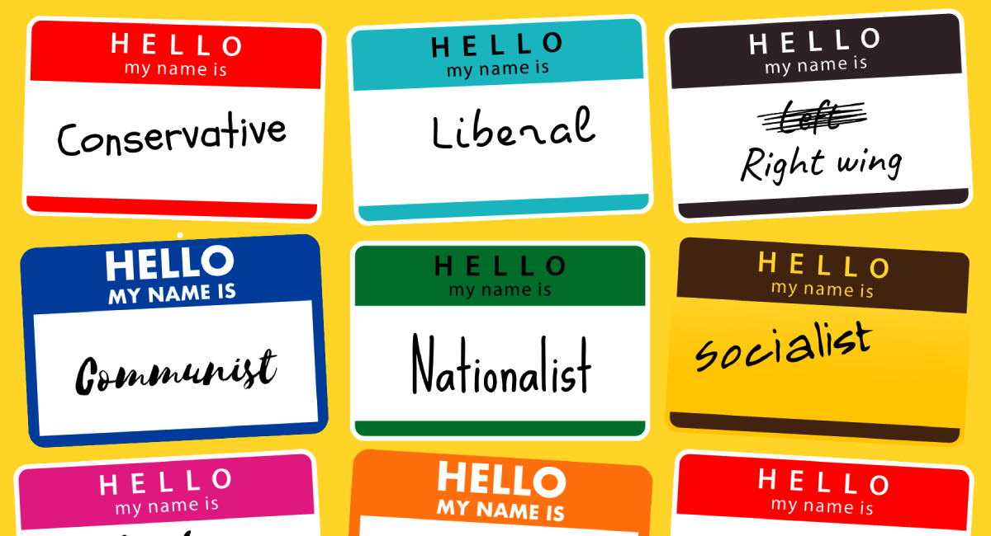
Politics

Slide 9
Personalities

Slide 10
And now… REDISTRICTING!

Slide 11
SB 13 Issues and Fixes
Dates
Secondary Problems
Correcting Errors

Slide 12
COVID-19
Omicron Variant
Vaccines, Mandates, Reactions
Economic Impact

Slide 13
Alternative Energy
Wind Farm Siting
Solar Siting
Energy Storage and Backup

Slide 14
Taxation
Health Clubs
Appraisal Methods
Exceptions for government competition
Sales taxes

Slide 15
Odds and Ends
Transportation
Broadband
KORA
Surveillance Restrictions

